Slide 1
Semi-Supervised Learning
CSCI 4360/6360 Data Science II

Slide 2
Supervised learning

Slide 3
Unsupervised learning

Slide 4
Semi-supervised learning
Basically a hybrid!
Given:
A pool of labeled examples L
A (usually larger) pool of unlabeled examples U
Can you improve accuracy somehow using U?

Slide 5
Semi-supervised Learning

Slide 6
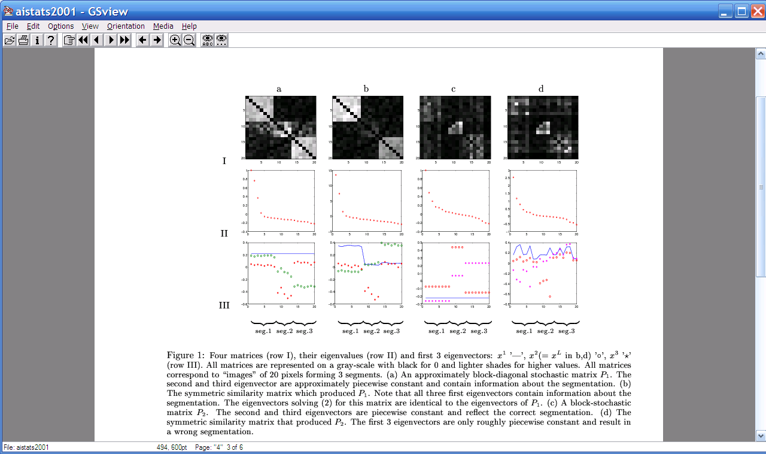
Spectral Clustering
Graph = Matrix
W*v₁ = v₂ “propogates weights from neighbors”
e₂
0.4
0.2
x
e₃
x
x
x
x
x
x
x
x
0.0
x
x
x
e₂
-0.2
y
z
y
y
z
-0.4
y
z
z
z
z
z
z
z
z
y
z
e₁
[Shi & Meila, 2002]
-0.4
-0.2
0
0.2

Slide 7
Semi-Supervised Learning as Label Propagation on a Graph
Propagate label to “nearby” nodes
X is “near” Y if there is a high probability of reaching Y from X
Propagation methods
Personalized PageRank
Random walk
Rewards multiple paths
Penalizes longer and “high fanout” paths
mayor of arg1
arg1 is home of
San Francisco
Austin
Paris
Pittsburgh
anxiety
live in arg1
traits such as arg1
denial
selfishness
Seattle
I like arg1
beer

Slide 8

ASONAM-2010 (Advances in Social Networks Analysis and Mining)

Slide 9
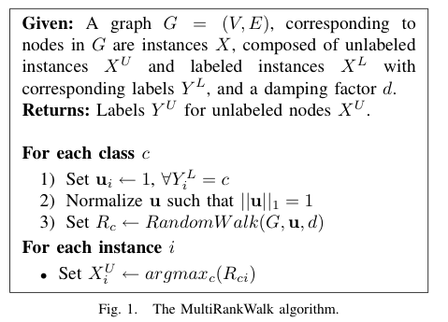
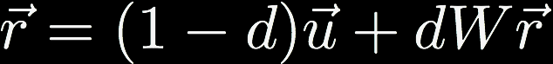
MultiRankWalk
Seed Selection
Order by PageRank or degree, or even randomly
Traverse list until you have k examples/class
Notes:
W is weighted transition matrix in graph (W_ij = 1 / degree(i))
u is normalized teleportation vector
r is ranking vector

Slide 10
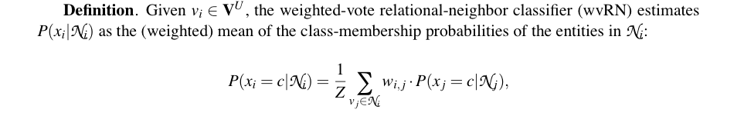
Comparison: wvRN
One definition [MacSkassy & Provost, JMLR 2007]:…
Does this look familiar?
Homophily!

Slide 11
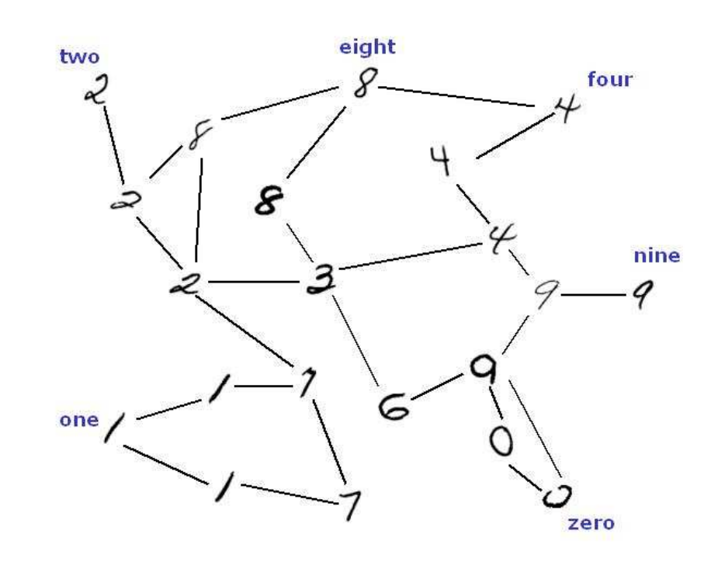
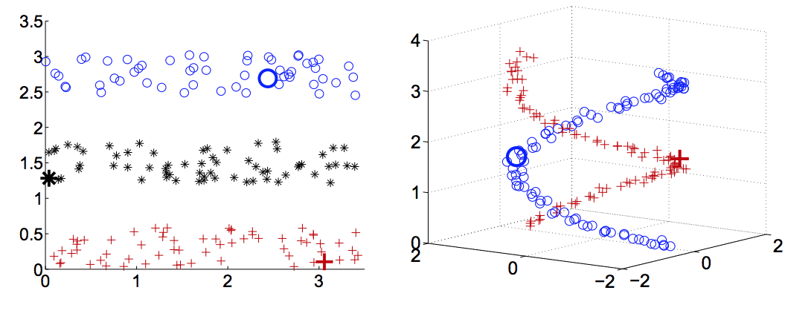
Comparison: HF
Another definition in [X. Zhu, Z. Ghahramani, and J. Lafferty, ICML 2003]
A harmonic field – the score of each node in the graph is the harmonic, or linearly weighted, average of its neighbors’ scores (harmonic field, HF)

Slide 12
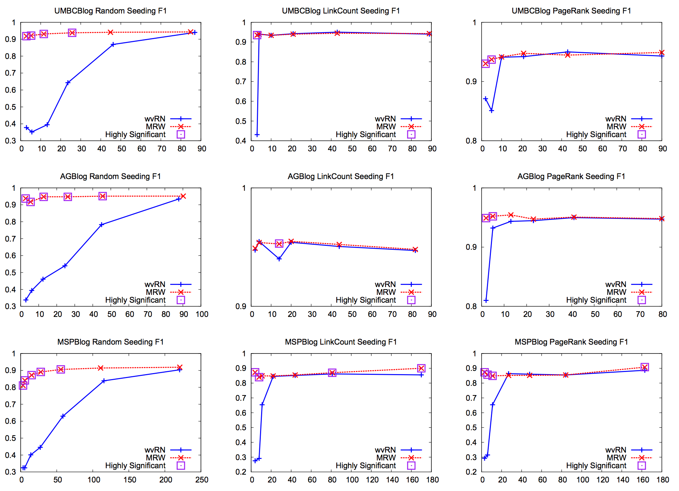
MRW versus wvRN
MRW is easily the method to beat
wvRN matches MRW only when seeding is not random
Still takes a larger number of labeled instances compared to MRW

Slide 13
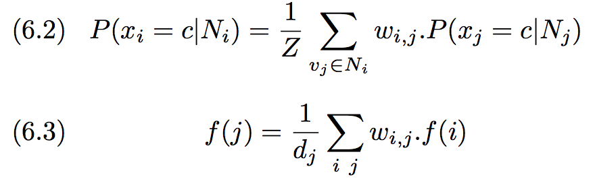
Why is MRW > wvRN?
Start with wvRN & HF objectives
Do not account for graph structure
Or location of seeds
Graph-walk methods do not have these constraints
And directly account for graph structure
Notes:
- In both cases, max value is 1 (that is constant value for labeled, & unlabeled cannot exceed labeled)
This constraint prevents any node—regardless of graph structure—to have more ”influence” over graph than a labeled seed
A particular unlabeled instance could in fact be well-connected to several labeled seeds of the same class and many unlabeled instances, and therefore should have more influence over the network

Slide 14
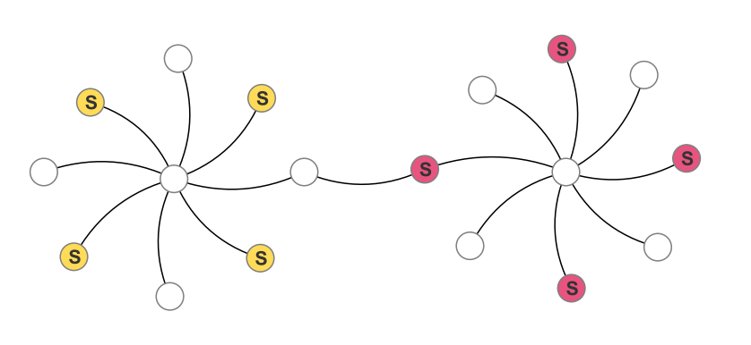
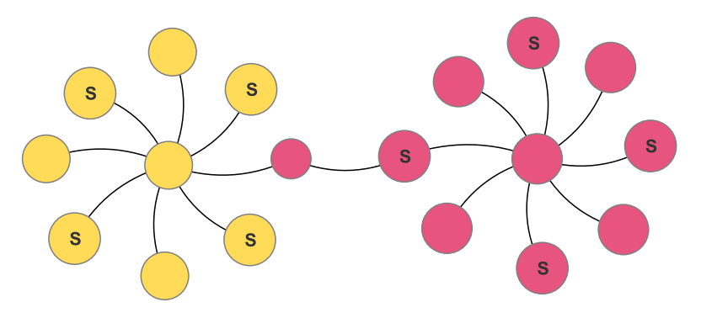
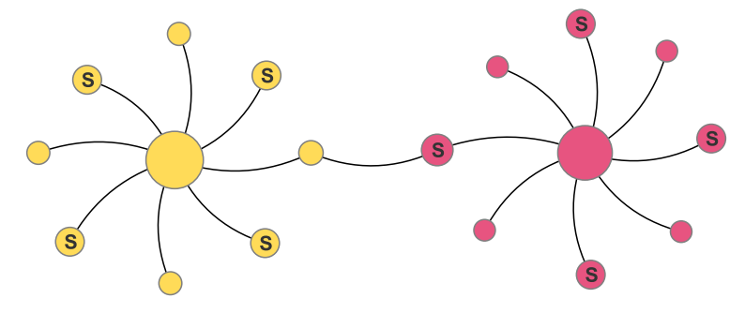
Why is MRW > wvRN?
Oops...
wvRN
MRW
Notes:
it shows that wvRN is more sensitive to the location of the labeled seed nodes; in this case, having a seed node near the fringe of the “cluster” resulted in an incorrect prediction.

Slide 15
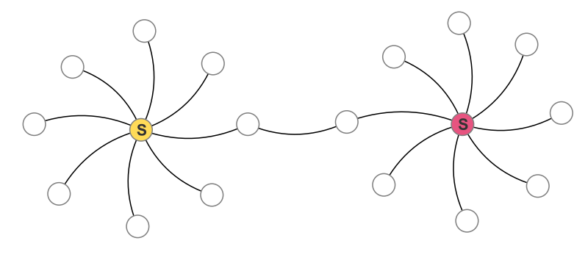
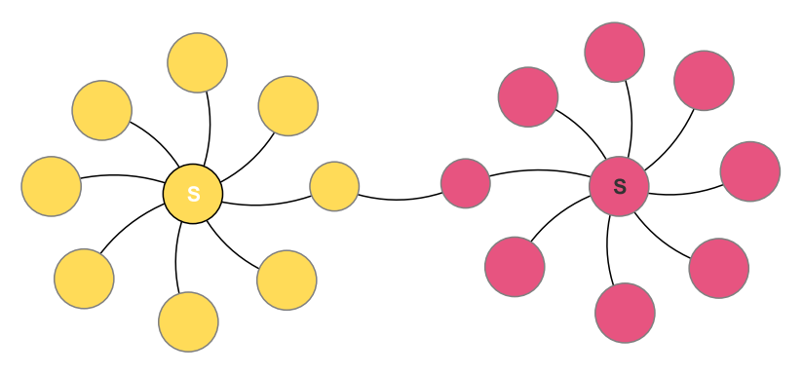
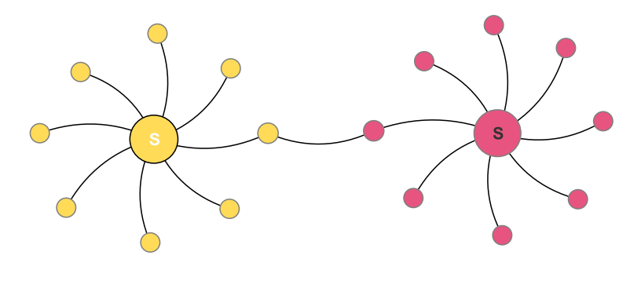
Why is MRW > wvRN?
wvRN
MRW
Notes:
Only when the seeds are optimally chosen does wvRN arrive at the same solution as MRW

Slide 16
Modern SSL
Graph Laplacians
Enforces graph structure
Imposes smoothness on labels
Graph embeddings
“Embedding” ~ “context”
Transductive -> Inductive
Transductive: learns the unlabeled data from the labeled data + structure
Inductive: generalizes to completely unobserved data

Slide 17
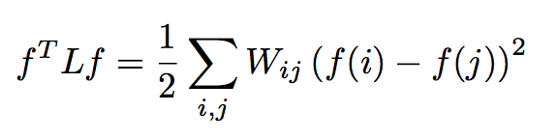
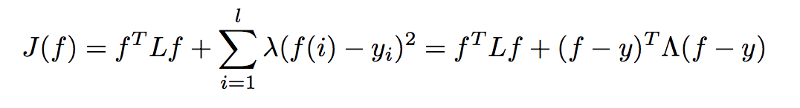
Graph Laplacians
Weighted sum of supervised loss over labeled instances
Reformulate SSL objective as two distinct terms:
Graph Laplacian regularization term
Notes:
f is some labeling function we want to learn
Laplacian regularization term is effective for multiple reasons
- propagates labels smoothly with respect to the graph (i.e. assumes nearby nodes have similar labels)
- induces a penalty when smoothness is violated
- constrains labels to be consistent with overall graph structure
Therefore, f is a label function that
- is smooth with respect to the graph
- is consistent with labeled data

Slide 18
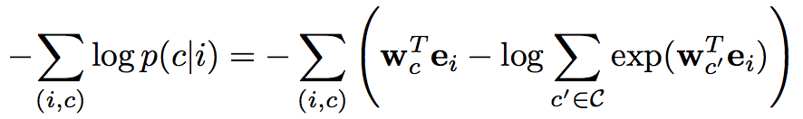
Graph Embeddings
Remember word embeddings with word2vec?
Context!
Estimate ”context” of each node with a random walk over neighborhood of a fixed window size
Skipgram-based model, DeepWalk
C is set of all possible context
w’s are parameters of Skipgram
e_{i} is embedding of node i
Notes:
Autoencoders have also been used to learn graph embeddings (2014 paper)

Slide 19
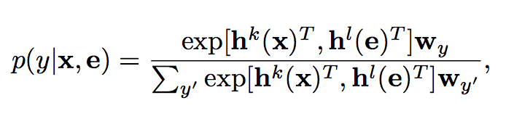
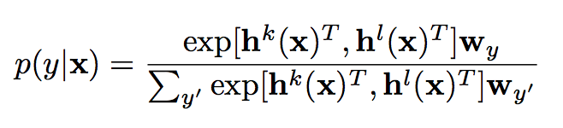
Inductive SSL
You start with X^{l} (labeled) and X^{U} (unlabeled), hoping their combination will result in a superior model
Semi-supervised learning yields predictions on X^{U}
Transductive learning
What if a completely unobserved data point shows up?
Inductive learning—a concept often left out in SSL literature
Convert your SSL framework to classification!
Transductive learning (note embeddings)
Inductive learning (dependent only on x)

Slide 20
Quick digression to unsupervised learning…

Slide 21
Spectral Clustering
Graph = Matrix
W*v₁ = v₂ “propogates weights from neighbors”
e₂
0.4
0.2
x
e₃
x
x
x
x
x
x
x
x
0.0
x
x
x
e₂
-0.2
y
z
y
y
z
-0.4
y
z
z
z
z
z
z
z
z
y
z
e₁
[Shi & Meila, 2002]
-0.4
-0.2
0
0.2

Slide 22
Repeated averaging with neighbors as a clustering method
Pick a vector v⁰ (maybe at random)
Compute v¹ = Wv⁰
i.e., replace v⁰[x] with weighted average of v⁰[y] for the neighbors y of x
Plot v¹[x] for each x
Repeat for v², v³, …
Variants widely used for semi-supervised learning
clamping of labels for nodes with known labels
Without clamping, will converge to constant v^{t}
What are the dynamics of this process?

Slide 23
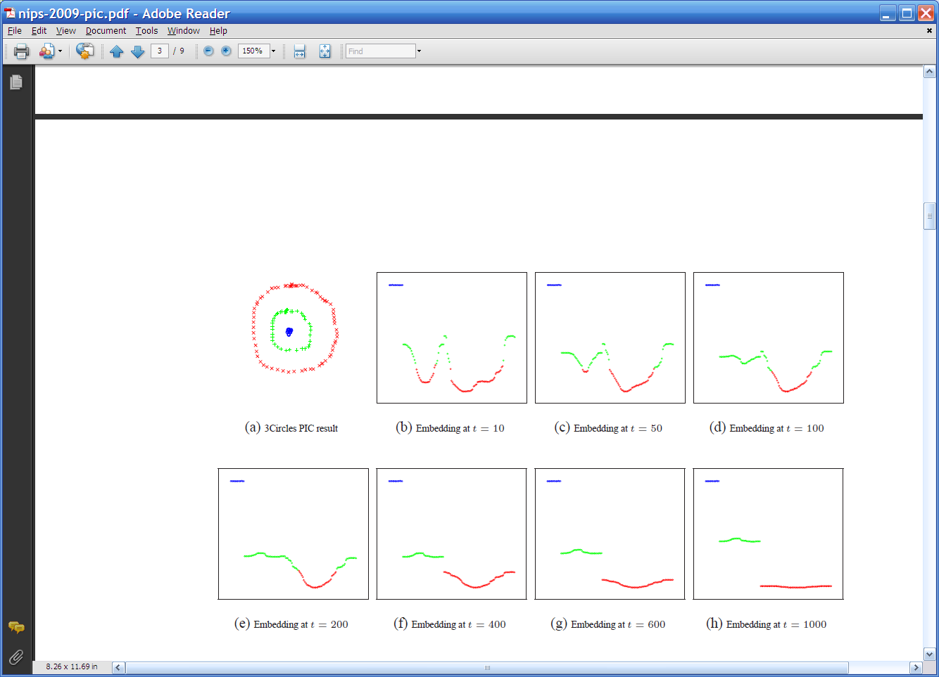
Repeated averaging with neighbors on a sample problem…
blue
green
___red___
Create a graph, connecting all points in the 2-D initial space to all other points
Weighted by distance
Run power iteration for 10 steps
Plot node id x vs v¹⁰(x)
nodes are ordered by actual cluster number
g
g
g
g
g
g
g
g
g
r
r
r
r
…
b
b
r
r
r
b
b
b

Slide 24
Repeated averaging with neighbors on a sample problem…
blue
green
___red___
blue
green
___red___
blue
green
___red___
larger
smaller

Slide 25
Repeated averaging with neighbors on a sample problem…
blue
green
___red___
blue
green
___red___
blue
green
___red___
blue
green
___red___
blue
green
___red___

Slide 26
Repeated averaging with neighbors on a sample problem…
very small

Slide 27
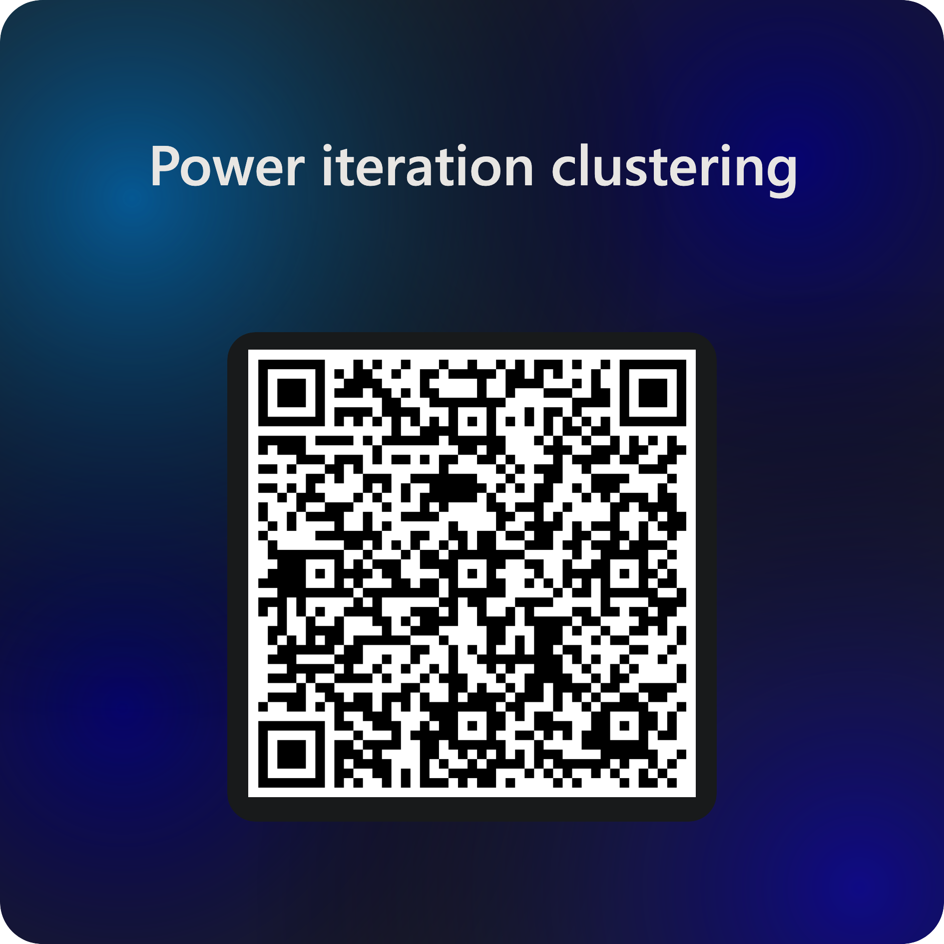


Slide 28
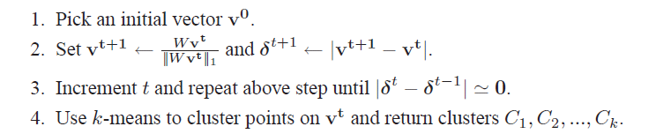
PIC: Power Iteration Clustering
Run power iteration (repeated averaging w/ neighbors) with early stopping
v⁰: random start, or “degree matrix” D, or others
Easy to implement, and relatively efficient (& easily parallelized!)
Empirically, often better than traditional spectral methods
Surprising given embedded space is 1-dimensional!

Slide 29
Summary
Contrast semi-supervised learning with supervised and unsupervised
Goal is not simply to train on labeled data and test on unlabeled data, but to develop a better model with both than would have been possible with either
Multi-rank Walk (MRW)
Works much like PageRank: walks the graph to infer unknown labels
Modern SSL strategies use the Laplacian of the graph
Yes, even in deep neural networks
Transductive vs Inductive SSL
Power iteration clustering (PIC)
Works on same principle as MRW
Similarity with spectral clustering

Slide 30
References
“Semi-Supervised Classification of Network Data Using Very Few Labels”, https://lti.cs.cmu.edu/sites/default/files/research/reports/2009/cmulti09017.pdf
“New Regularized Algorithms for Transductive Learning”, http://citeseerx.ist.psu.edu/viewdoc/download?doi=10.1.1.220.42&rep=rep1&type=pdf
“Semi-supervised Learning in Gigantic Image Collections”, http://papers.nips.cc/paper/3633-semi-supervised-learning-in-gigantic-image-collections.pdf
“Revisiting Semi-Supervised Learning with Graph Embeddings”, http://proceedings.mlr.press/v48/yanga16.pdf

Slide 32
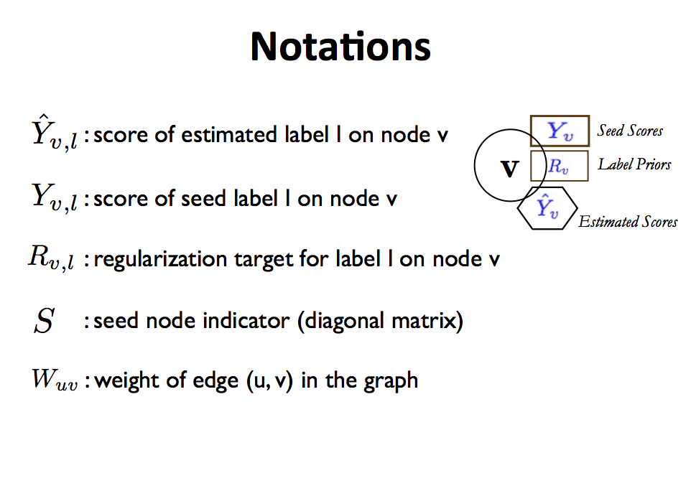

Slide 33
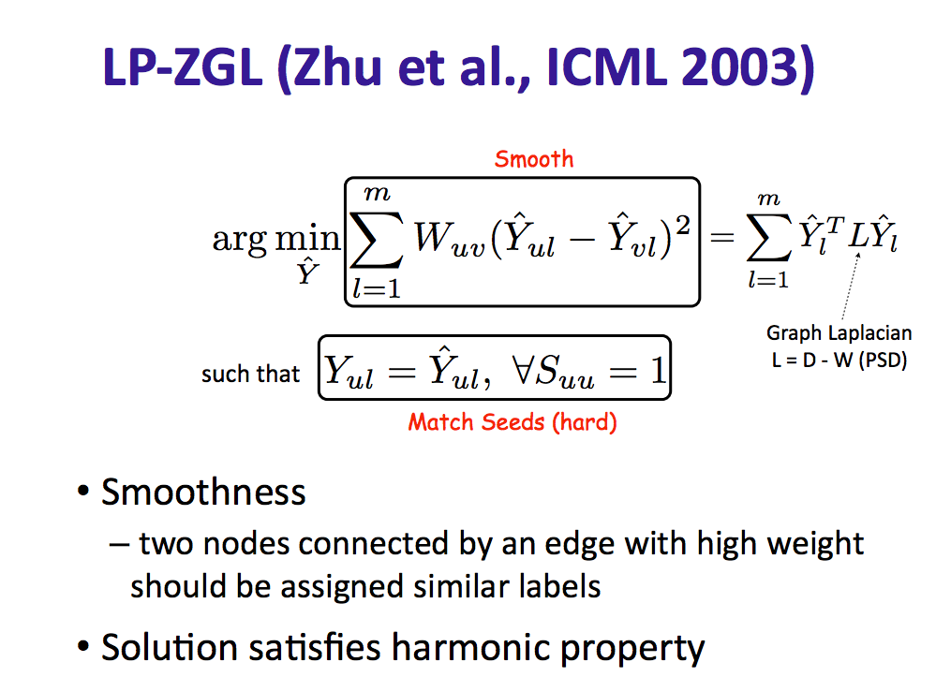

Slide 34
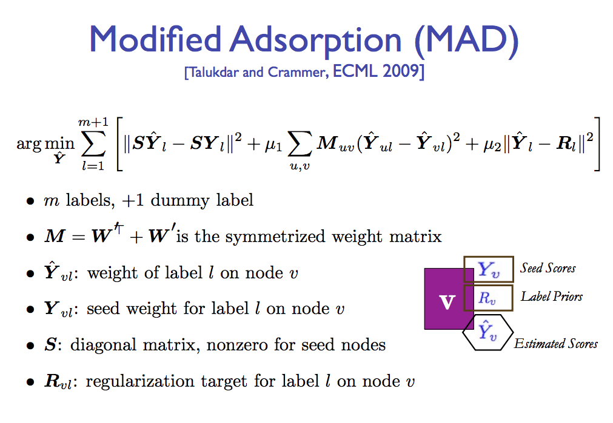

Slide 35
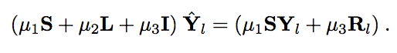
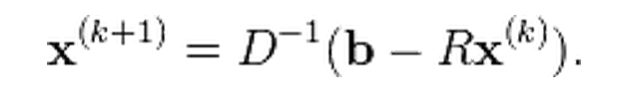
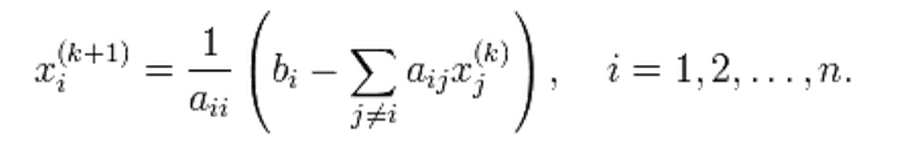
How to do this minimization?
First, differentiate to find min is at
Jacobi method:
To solve Ax=b for x
Iterate:
… or:

Slide 36
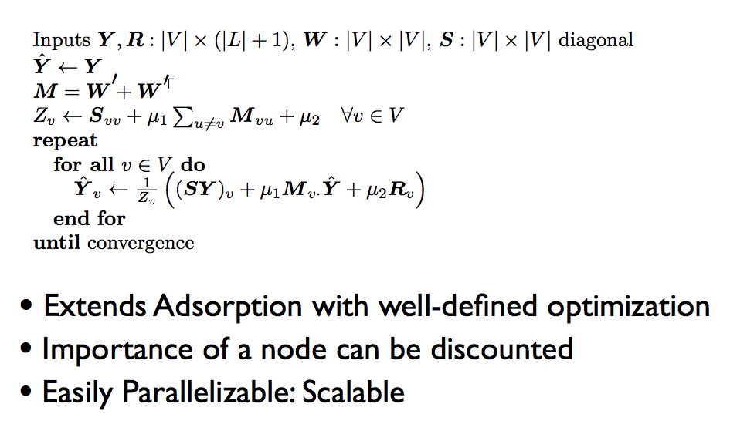

Slide 37
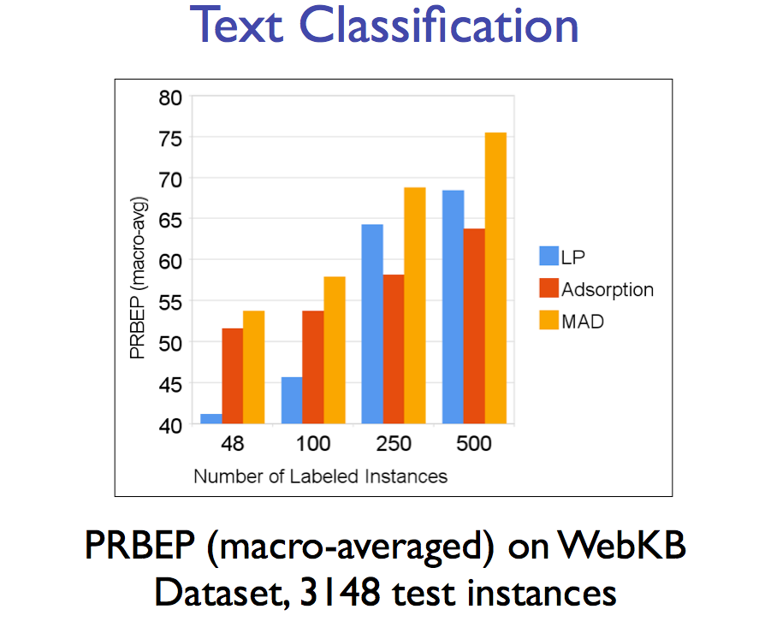

Slide 38
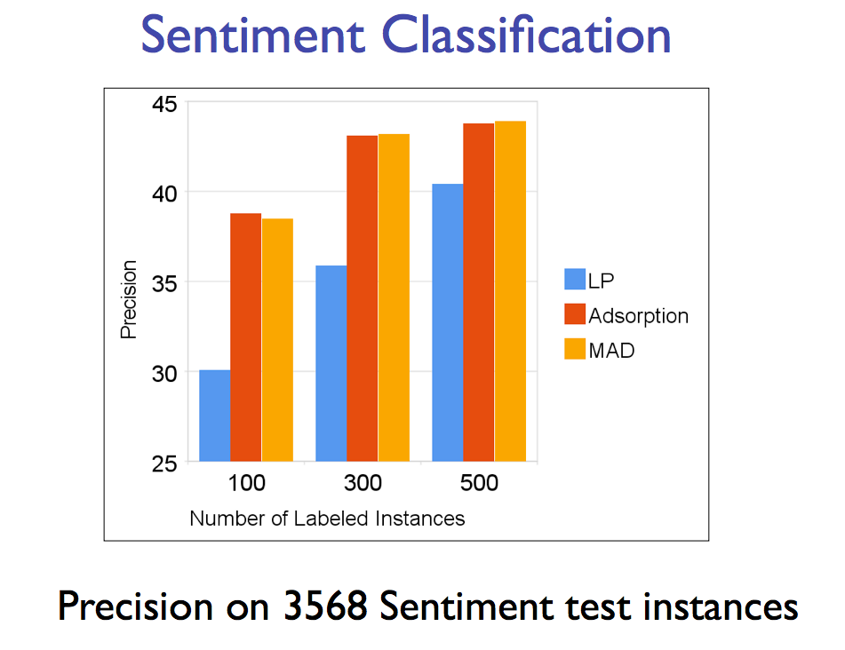

Slide 39
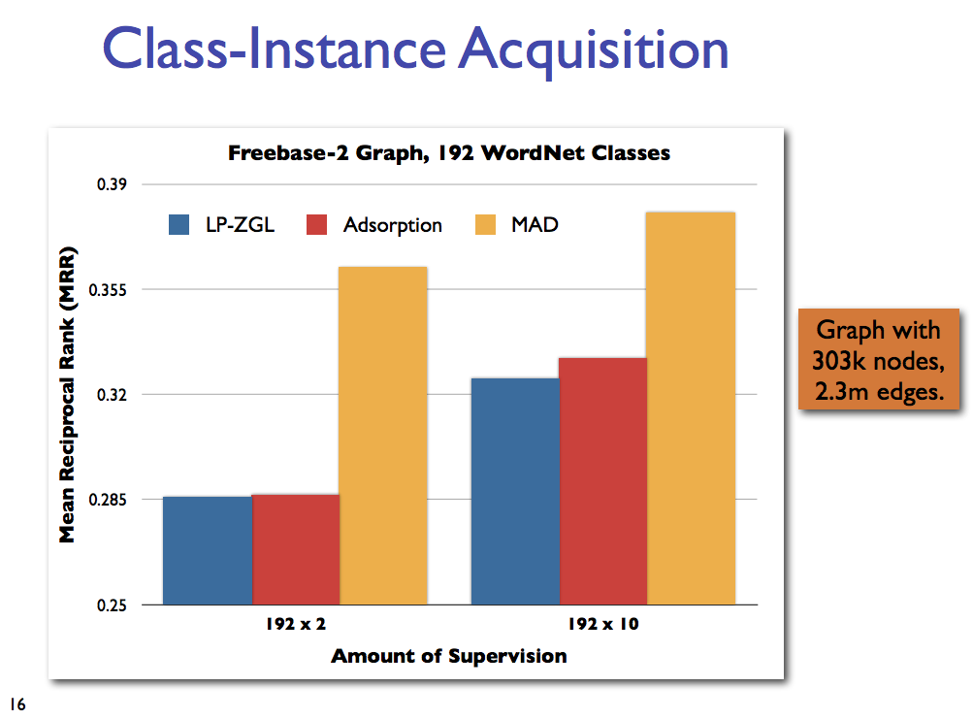

Slide 40
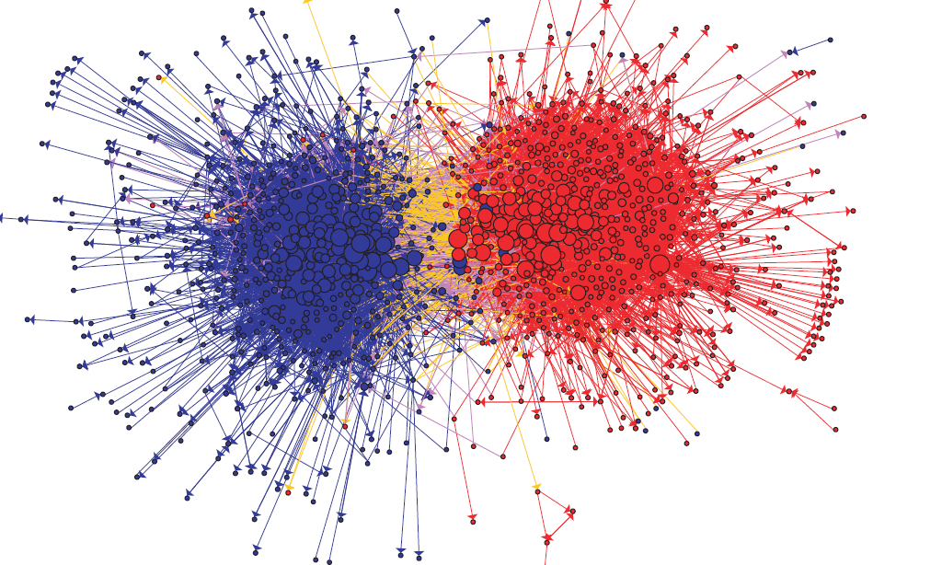
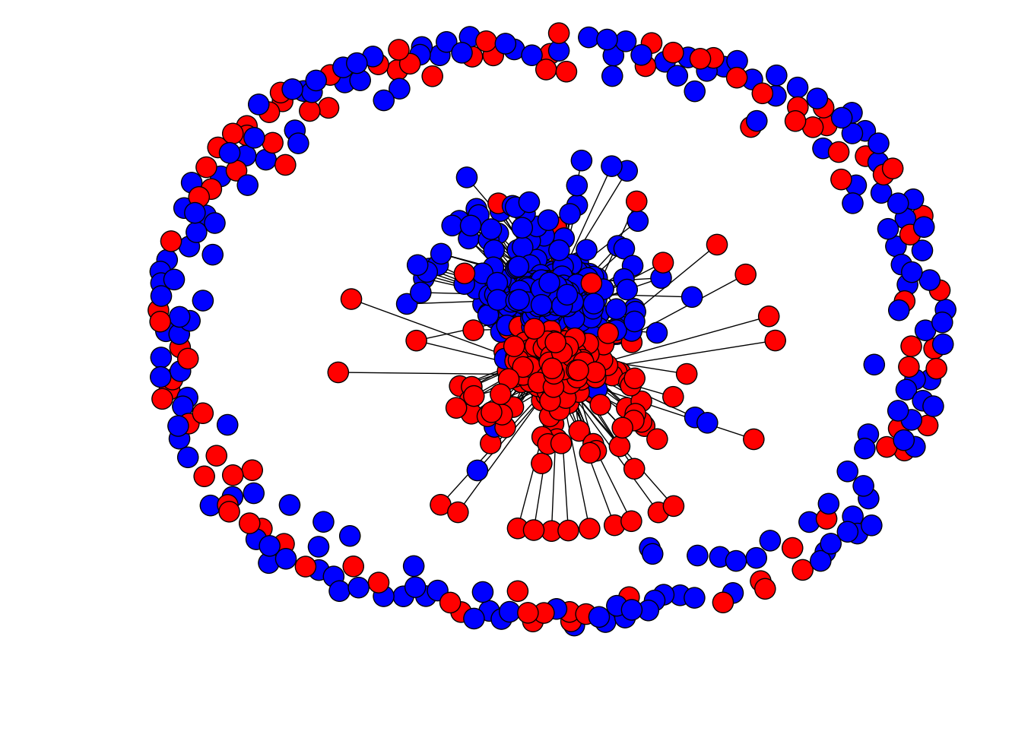
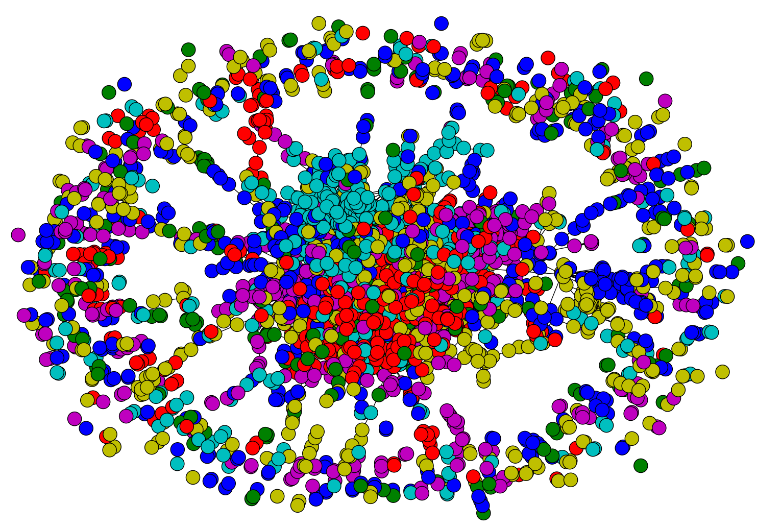
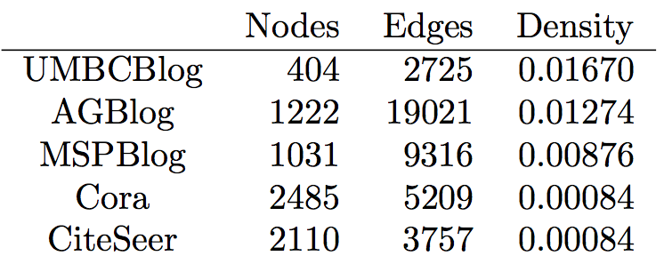
Network Datasets with Known Classes
UBMCBlog
AGBlog
MSPBlog
Cora
Citeseer
Notes:
UBMCBlog: 404 blogs labeled as conservative or liberal
AGBlog: 1222 blogs labeled as either conservative or liberal
MSPBlog: 1031 blogs labeled as either conservative or liberal
Cora: 2708 papers from 7 categories
CiteSeer: 3312 papers from 6 categories

Slide 41
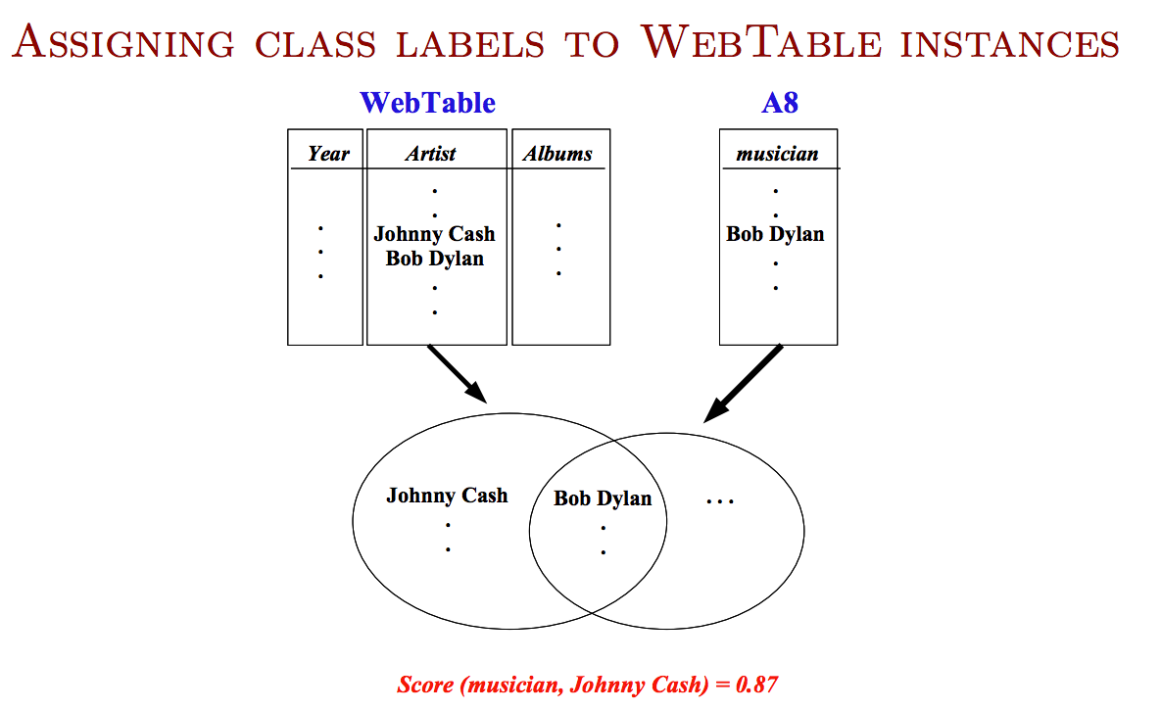

Slide 42
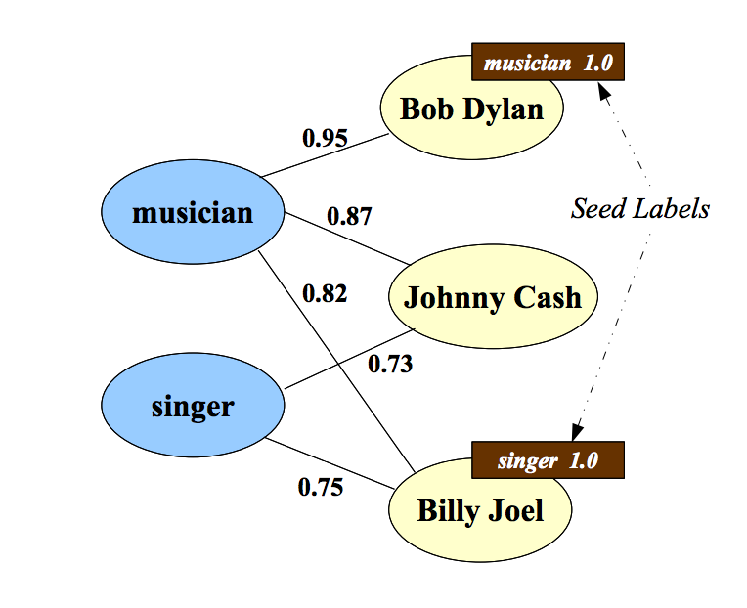

Slide 43
